Slide 1
COMPUTER MAIN PARTS
Sebastián Álvarez Henao.

Slide 2
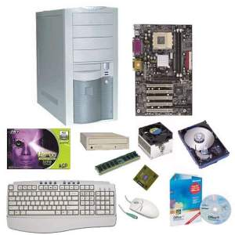
HARDWARE
It refers to all physical parts of a computer system; its components are: electrical, electronic , electromechanical and mechanical .

Slide 3
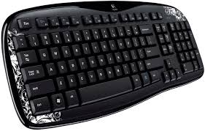
KEYBOARD
The principal input device; used to type instructions into the computer.

Slide 4
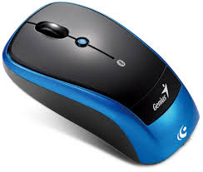
MOUSE
A pointing device used to make on-screen selections.

Slide 5
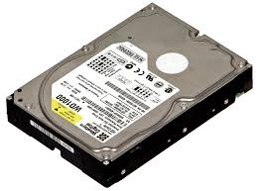
HARD DRIVE
Located inside the system unit and used to store programs and most data.

Slide 6
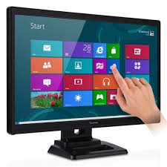
MONITOR
An output device that lets you see your work as you go.

Slide 7
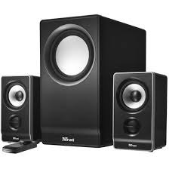
SPEAKERS
Used to produce audio output.

Slide 8
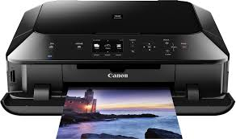
PRINTER
Produces printed copies of computer output.

Slide 9
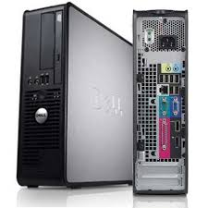
SYSTEM UNIT
The case that contains the CPU, memory, the power supply, disk drives, and all other hardware.

Slide 10
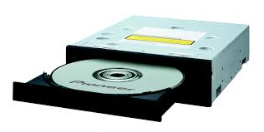
CD/DVD DRIVE
Reads CD/DVD discs.

Slide 11
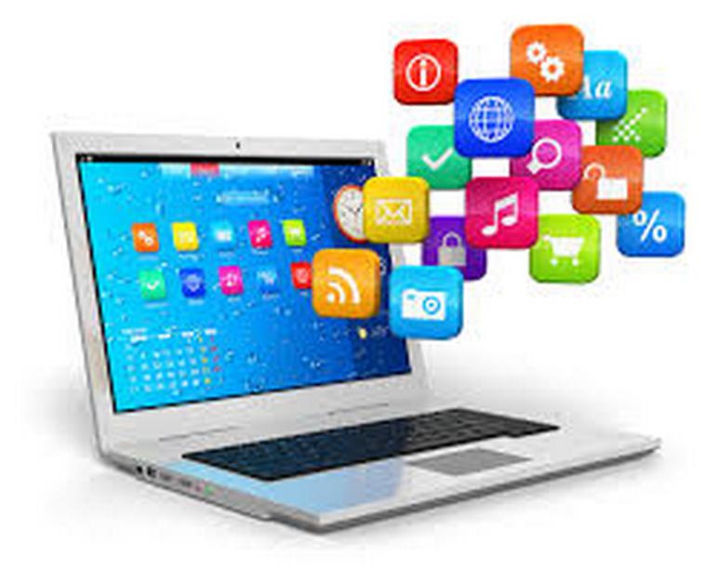
SOFTWARE
Given this definition, the concept of software goes beyond computer programs in its different states: source, binary or executable code; Also documentation, data processing and even user information part of the software: that is, all-encompassing intangible, nonphysical everything related.

Slide 12
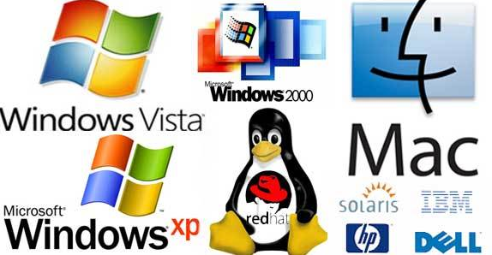
TIPOS DE SOFTWARE
System Software:
Is what allows us to establish an interaction with hardware, through programs that manage resources and provide an interface to use. The best example in this regard are the popular operating systems like Windows, Linux or Mac OS.

Slide 13
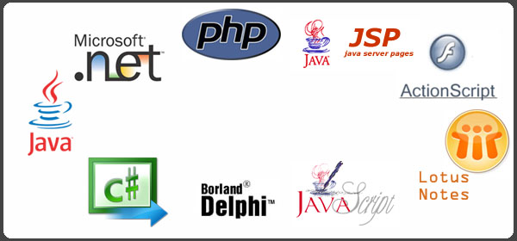
Programming software:
Programming software: As the name implies, is software that allows us to program or develop a computer program through use of logical rules and specific language, which allow us to shape it.

Slide 14
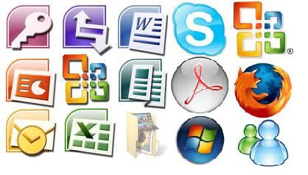
Software Application:
This type of software to perform specific tasks. Therefore, this software focuses only on one aspect or resolution of a particular problem and not, as do system software, to provide a much more complex overall functioning.

